Slide 1
Deep Learning Inference for Next-generation Wireless Networking Project Update #12 with Intel Labs November 6, 2017 (Version 1.1 Updated 11/6/17) HT Kung Harvard University
PRE-PUBLICATION RESULTS: NOT FOR PUBLIC DISTRIBUTION

Slide 2
Agenda
Big Picture: A Data-Driven Neural Network for Modulation Classification and Demodulation
A Complex Valued Neural Network for Capturing Phase Information for Modulation Classification
RadioML Dataset, Experiments and Results
Preparing for Real World Scenarios with GAN Augmented Data
Experimental Results Utilizing GAN-generated Data
Notes:
Argue why we think we can train these and generate data that is “unseen”

Slide 3
Big Picture: Our Proposed Neural Network Demodulation Pipeline
Several typical processing blocks of a prototypical wireless demodulation pipeline are shown on the left, including time synchronization, multipath equalization, phase correction, and constellation decoding
On the right, we propose to replace it with two blocks, one CNN for modulation classification and another for performing demodulation based on the determined coding scheme
I/Q
Data
MCS set in Header over BPSK
Time Synchronization (e.g. Polyphase Clock Sync)
CNN Modulation Classification
CNN Demodulation
I/Q
Data
Equalization for Multipath (e.g. CMA or LMS-DD)
Phase and Frequency Correction (Costas Loop)
Constellation Decoding
Basic Demodulation Pipeline (Phase based Modulation Scheme)
Our Proposed Data-driven Demodulation Pipeline

Slide 4
Focus For This Presentation: Modulation Coding Scheme Classification and Synthetic Data Generation
Consider an adaptive modulation paradigm where the transmitter can utilize any modulation scheme and the receiver must be able to determine how to demodulate quickly without a predetermined protocol or coordination
Accurate modulation scheme classification allows for immediate use of the channel, instead of wasting channel resources coordinating modulation scheme information
Our target pipeline will use a completely data-driven approach for the demodulation of wireless data, including automatic modulation coding scheme classification and signal demodulation (complete demodulation is future work)
A data-driven approach allows for the classification and demodulation to be tuned per environment and even per device, capturing environmental factors like multipath and device characteristics, phase and timing errors
This will allow for improved data rates by achieving accurate classification and demodulation at lower SNRs
In order to train these models accurately and generally (e.g., for changing environments), we require sufficient training data. We address this issue with Generative Adversarial Models (GANs) in the second half the presentation.

Slide 5
RadioML Dataset - IQ Data with Modulation Scheme and SNR Values
We utilize RadioML, a publically available dataset that was created using GNU-Radio:
The dataset consists of 11 different modulation schemes (BPSK, QPSK, 8PSK, PAM4, QAM16, QAM64, GFSK, CPFSK, FM, AM, AMSSB)
Each modulation scheme is captured at several different Signal-to-Noise Ratios (SNRs) ranging from -20 dB to 18 dB, under a dynamic channel model (GNU-Radio)
Each example is 128 points of complex values (I/Q) corresponding to 16 symbols, with 8 samples per symbol (For example, for QPSK 32 bits are being transmitted, 2 bits per symbol)
There are roughly 150,000 examples in the entire dataset
The goal is the classify the modulation coding scheme given the 128 received complex values
We utilize 90,000 examples for training and 60,000 examples for evaluation
The RadioML dataset has a benchmark CNN model (“VTCNN2”) that we use as a baseline for comparing against two of our own designed and trained models:
A real-valued network (“Real Valued Network”)
A complex-valued network with 50% of the number of layers (“Complex-Valued Network”)
This dataset is also used for training the GAN models discussed later

Slide 6
Agenda
Big Picture: A Data-Driven Neural Network for Modulation Classification and Demodulation
A Complex Valued Neural Network for Capturing Phase Information for Modulation Classification
RadioML Dataset, Experiments and Results
Preparing for Real World Scenarios with GAN Augmented Data
Experimental Results Utilizing GAN-generated Data
Notes:
Argue why we think we can train these and generate data that is “unseen”

Slide 7
Complex-Valued Neural Network for Phase Information
Phase information is critical for understanding the coding scheme and for performing demodulation
We know that complex values are naturally used to represent phase information
Unfortunately, we cannot just replace real values with the complex values and train current implementations of Neural Networks as it lacks representation of ordering between complex values
Generally, the networks either operate only on amplitude information or use an ad-hoc approximation (we refer to as a “Real-Valued Network”) by using both real (I) and imaginary (Q) components as separate vectors
The typical neuron operation, an inner product, real-valued multiplication is not equivalent to a complex-valued multiply as we will see on the next slide
We follow the new design based on work by Trabelsi et. al. to implement a complex-valued DNN in order to classify the modulation coding scheme given the I/Q examples
The “Complex Valued Network” utilizes just 2 convolutional layers and 2 fully connected layers, which is > 50% smaller than the compared two real-valued networks

Slide 8
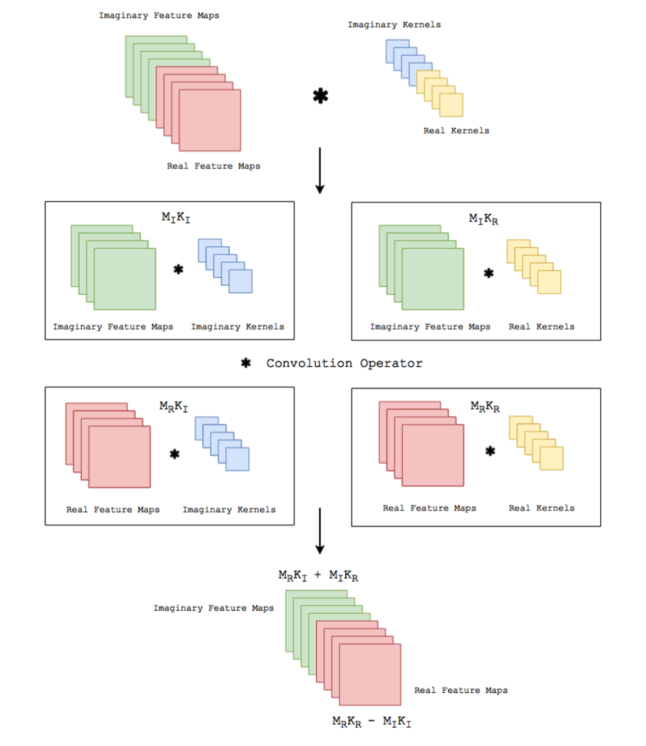
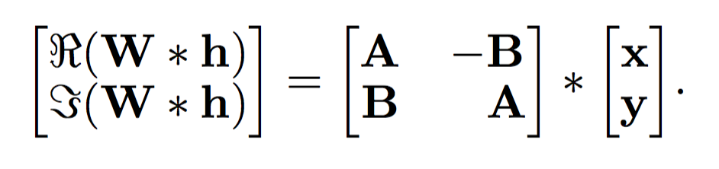
Complex-Valued Neural Network - Convolution Implementation
We can correctly compute the complex convolution by separating the real and imaginary parts for both the inputs and the kernel parameters (1)
We can then combine them to match the equation below by doing (2)
A and B are learned parameters
(1)
y
B
A
x
B
y
B
x
y
x
Matrix Form:
A
A
A*y + B*x
(2)
W*h =
A*x - B*y
Real
Imaginary

Slide 9
Agenda
Big Picture: A Data-Driven Neural Network for Modulation Classification and Demodulation
A Complex Valued Neural Network for Capturing Phase Information for Modulation Classification
RadioML Dataset, Experiments and Results
Preparing for Real World Scenarios with GAN Augmented Data
Experimental Results Utilizing GAN-generated Data
Notes:
Argue why we think we can train these and generate data that is “unseen”

Slide 10
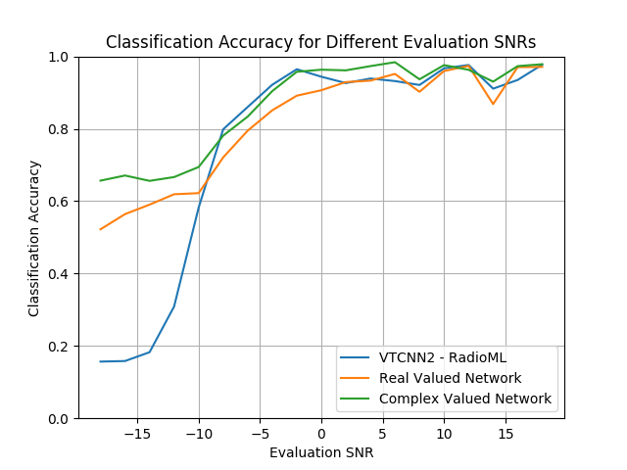
Performance of Our Real and Complex Valued Classifiers Against the Baseline RadioML Classifier
We compare the following 3 networks:
The “VTCNN2” is the baseline CNN implementation
Our “Real-Valued Network” which is larger and carefully tuned
Our “Complex-Valued Network” which has only 2 convolutional layers and 2 fully connected layers
Our Complex-Valued Network (green) provides an improvement of roughly 10% over the tuned, Real-Valued Network (orange) and by 50% over the baseline model (Blue)
-

Slide 11
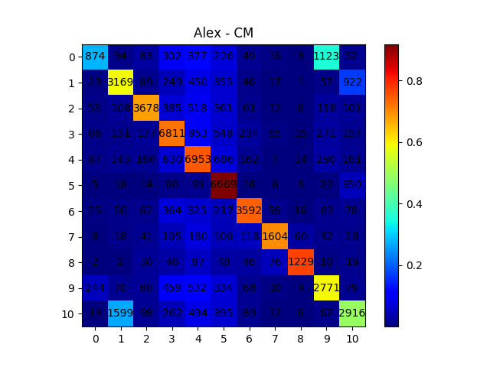
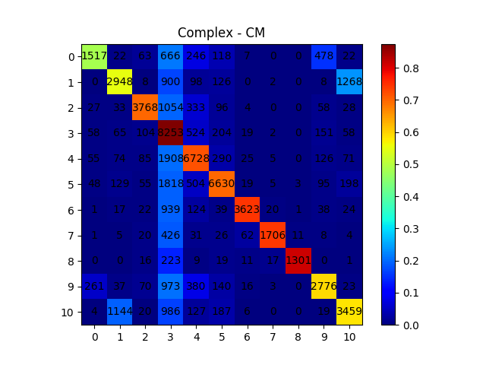
Captured Phase Information of Complex Convolution for Distinguishing 8PSK vs QPSK
QPSK
8-PSK
For the real-valued network, it almost always predicts that 8-PSK (phase shift keying with 8 constellation points) is QPSK
The complex-valued network, it correctly predicts 8-PSK, improving by a factors of > 2x.
Notes:
White numbers - MBC WILL FIX THIS

Slide 12
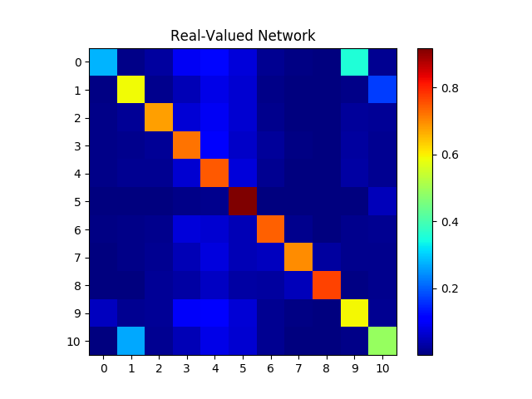
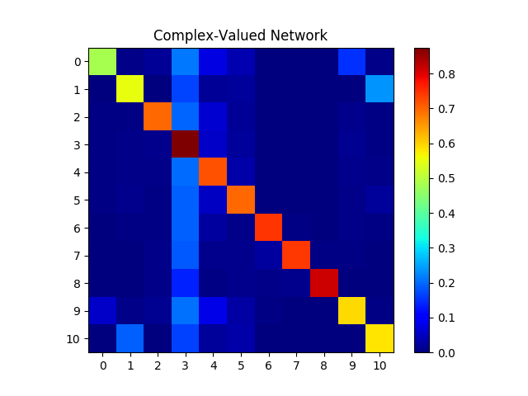
Captured Phase Information of Complex Convolution for Distinguishing 8PSK vs QPSK
QPSK
QPSK
8-PSK
874
1123
8-PSK
1517
478
2771
2776
For the real-valued network, it almost always predicts that 8-PSK (phase shift keying with 8 constellation points) is QPSK
The complex-valued network, it correctly predicts 8-PSK, improving by a factors of > 2x.
Notes:
White numbers - MBC WILL FIX THIS

Slide 13
Agenda
Big Picture: A Data-Driven Neural Network for Modulation Classification and Demodulation
A Complex Valued Neural Network for Capturing Phase Information for Modulation Classification
RadioML Dataset, Experiments and Results
Preparing for Real World Scenarios with GAN Augmented Data
Experimental Results Utilizing GAN-generated Data
Notes:
Argue why we think we can train these and generate data that is “unseen”

Slide 14
Preparing for Real World Scenarios with GAN-augmented Data
For the RadioML dataset, the channel model is simple, dominated primarily by thermal noise (Additive White Gaussian Noise) and simple multipath, delay and fading models
However, in the real world, the situations are significantly more complicated than the RadioML dataset
For example, data in the real world will be affected by more complex types of noise but have structure, such as multipath and phase noise (e.g., the oscillators of each device)
For our initial validation of GANs, we use the RadioML dataset and the SNR values as a proxy for the channel
In the future, we will use USRPs to collect real-world data in a variety of scenarios to train our GAN models
This collected dataset will be more realistic, capturing both device characteristics such as phase noise, important for high frequency devices and features associated with the environment (e.g., complex multiple behavior, fading, etc.)

Slide 15
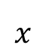
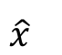
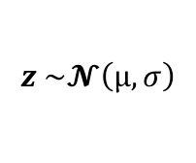
Review: Conditional GAN for SNR Information
Conditional side information
$$x$$
y
Generator
Discriminator
real/fake
$$\hat{x}$$
Noise
z
condition
$$z \sim \text{𝓝}\left(μ,σ\right)$$
We commonly condition a GAN on side information y (such as SNR value) such that generated data will satisfy some condition of interest
In a neural network implementation, G takes in [z, y] as a single input vector, concatenating z and y
We will use a conditional GAN in the rest of the presentation and is used in our experiments and results
Notes:
We need

Slide 16
GAN-based Data Generation: Motivation
Consider the following scenario:
It is only possible to collect a small number of real world data points, and only observe SNR values 6, 8, 16, and 18
However, we need to train a model that works not only at SNR values 6, 8, 16, and 18, but at 10, 12, and 14 as they could observed in a new environment or at a later time
There is a potential pitfall of overfitting as the training set is small and there are no examples at several SNR values leading to poor generalization of the model
In general, there are multiple challenges in collecting real world datasets to be used for training machine learning models
It is impractical to collect data under all possible settings (e.g., different SNR values)
It is expensive to collect large amounts of data even under just a few scenarios

Slide 17
GANs as a Tool for Synthetic Data Generation
GANs are one mechanism that can produce two desirable effects:
GANs can create synthetic data for conditions not represented in the dataset, allowing the model to generalize better to data inputs of unseen type (e.g., SNR values not in the original dataset)
GANs can augment a small dataset, making it sufficiently large to train a model successfully, reducing the risk of overfitting
In the next section, we show example data generated for a GAN trained on the RadioML dataset and use SNR as a proxy for different channel conditions
Note that we use the RadioML dataset only for preliminary results. We will capture real I/Q measurements with a set USRPs in different environments in the future
Our initial task is to predict the SNR of the input signal (using a regression model)
We show that our model trained on a dataset augmented with synthetic data outperforms one trained on a more restricted dataset

Slide 18
Agenda
Big Picture: A Data-Driven Neural Network for Modulation Classification and Demodulation
A Complex Valued Neural Network for Capturing Phase Information for Modulation Classification
RadioML Dataset, Experiments and Results
Preparing for Real World Scenarios with GAN Augmented Data
Experimental Results Utilizing GAN-generated Data
Notes:
Argue why we think we can train these and generate data that is “unseen”

Slide 19
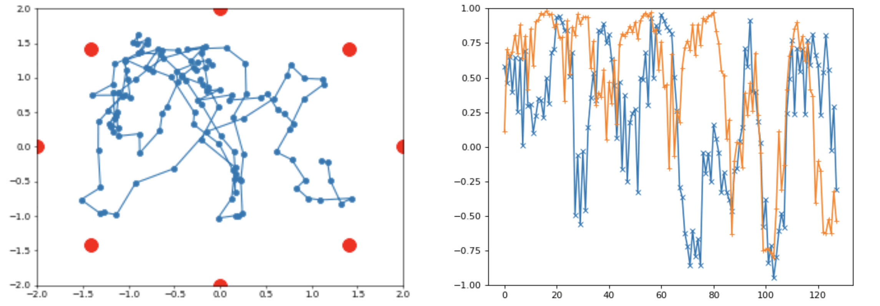
Understanding the Graphics
Constellation Plot
(each point corresponds to one of the 128 points)
I/Q Data Plot
(orange line is I data and blue line is Q data, the x-axis index corresponds to a sample point)
We train a GAN with a generator G and discriminator D on examples of I/Q data with different bit sequences, modulation schemes, and SNR values
For each Z vector = [z, SNR] fed into the Generator, the Generator will generate 128 points of I/Q data, trying to convince the Discriminator it is a real example
We can visualize this data generated by the Generator, as shown in the image above
Shown as in a constellation view (left hand side)
Shown as in-phase (orange) and quadrature (blue) components over time

Slide 20
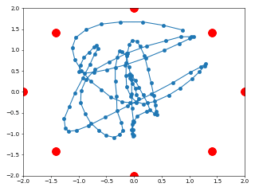
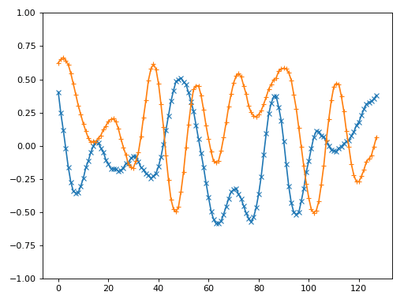
Synthetically Generated I/Q Data for Increasing SNR Values for a Particular Modulation and Bit Sequence
The animation on the right is generated by feeding a “query signal” at a given SNR into the Encoder, resulting in a Z vector = [z, SNR]
We fix z (reflecting the data bits and modulation scheme), and interpolate over different values of SNR to form a set of Z vectors
We feed these Z vectors into the generator to generate the signals at different SNR values all for the same “query signal”
Notes:
I think we should just say we randomly sample a z and select the SNR. The z corresponds to a particular set of bits, or a modulated wave form, which we fix
We never mention encoder so just stick with generator

Slide 21
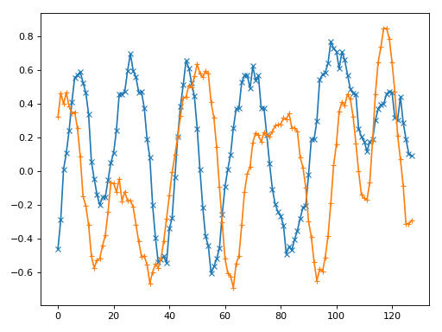
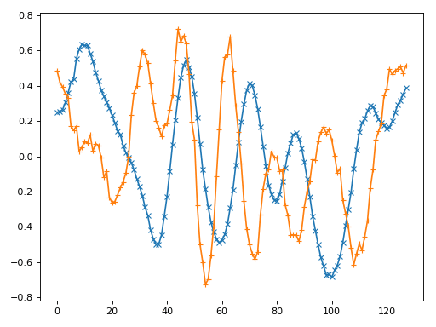
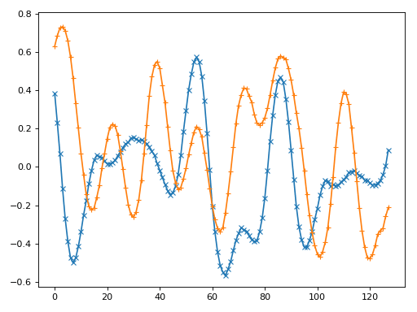
Generation of More Signals Close to an Input Signal
We can generate a large number of signals similar to a given input signal by just slightly changing the random component of z.
We can generate these signals not just on signals with SNRs used in training the network, but also on signals with previously unseen SNRs!
To validate the SNR of the generated signal, we train an out-of-band (non-GAN) classifier on every all SNR levels
We find that the GAN generated data is correctly classified with the appropriate SNR value with this out-of-band classifier
SNR 6
SNR 12
(NEVER SEEN IN TRAINING DATA BUT ACCURATELY GENERATED)
SNR 18

Slide 22
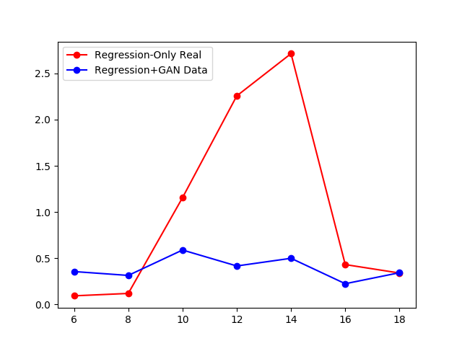
Successful Classification for Unseen SNR Values Using GAN-generated Training Data
We now compare models with and without GAN-augmented data to predict the SNR of an input signal
Consider a dataset that contains data points collected only at SNR values {6, 8, 16, 18}
The red line is a regression model trained only on the collected dataset
We also train a GAN that is capable of generating additional training I/Q data, as well as generating training data at previously unseen SNR values {10, 12, 14}
The blue line is a regression model trained on this augmented dataset
While the regression model trained only on the collected dataset has high error at previously unseen SNR values, the regression model trained on the dataset augmented with the GAN data is able to operate correctly at these previously unseen SNR values
Error
SNR

Slide 23
Conclusion
Complex valued neural networks execel at distinguishing phased-based modulations
Generator can be used as if it’s a channel simulator that can generate data for training classifier under different SNR values

Slide 24
Conclusion
Our implementation of a Complex-valued neural network is shown to be good at capturing and distinguishing phase information useful for classifying modulation schemes
The complex-valued network is also much more efficient as it requires 50% fewer layers and achieves higher overall accuracy
Generator can be viewed channel simulator that can generate additional training at different SNR values in order to train a classifier and reduce overfitting
We show this approach improves accuracy significantly for unseen SNR levels
We will replace the RadioML dataset with real-world dataset after our collection of data using the USRPs

